Slide 1
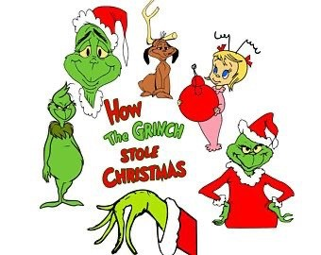
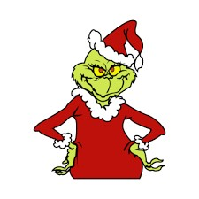
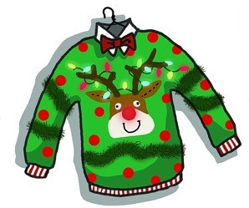
MRS.PEACOCK’S
December 18-22, 2023
Weekly Skills
Reminders
ELA: Review Week using holiday themed stories
PHONICS: Review previous skills
LANGUAGE: Review Week
MATH: Review Week
*Please send $1 for our custodian’s Christmas to show our appreciation for their hard work!
* Please send $2 for our Christmas party.
COMING UP @ NORTHSIDE
MONDAY- RUDOLPH DAY! DECK OUT IN ALL YOUR RED!
TUESDAY- ROCKING AROUND THE CHRISTMAS TREE! WEAR GREEN!
PBIS STORE
WEDNESDAY- GRINCH DAY! DRESS AS YOUR FAVORITE GRINCH/WHOVILLE CHARACTER!
THURSDAY- TACKY SWEATER OR HOLIDAY ATTIRE! CHRISTMAS PARTY DAY! ( NO GUESTS! )
FRIDAY- EARLY DISMISSAL DAY! LUNCH WILL NOT BE PROVIDED.
DECEMBER 22 - JANUARY 5: CHRISTMAS HOLIDAYS!

